Slide 1
Operating System(22516) Unit-4 CPU Scheduling and Algorithms Marks: 14
Prepared by:
Mrs. Kousar Ayub A.
Lecturer(Selection Grade)
Computer Engg. Dept
M. H. Saboo Siddik Polytechnic

Slide 2
Learning Outcomes
The learners will be able to:
Define Scheduling Types
Different Types Of Scheduling Algorithm
Deadlocks

Slide 3
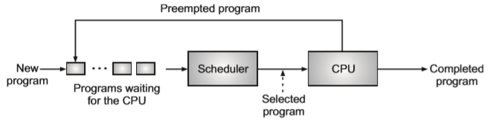
Scheduling Concept
Scheduling is an important function of an operating system. The process scheduling is the activity of the process manager that handles the removal of the running process from the CPU and the selection of another process on the basis of a particular strategy.
The scheduler is the kernel component (module/program) responsible for deciding which program should be executed on the CPU. A scheduler selects a job/task which is to be submitted next for execution.
When it receives control, the scheduler the program and gives the CPU to another program. The function of deciding which program should be given the CPU, and for how long, is called scheduling.

Slide 4
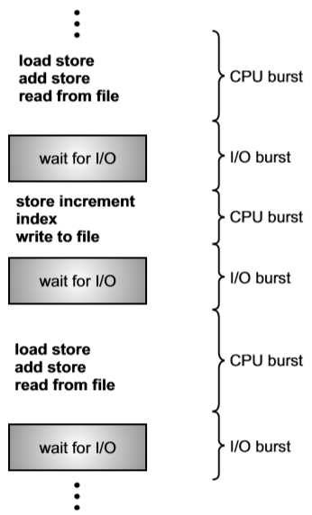
CPU and I/O Burst Cycles
CPU scheduling is greatly affected by how a process behaves during its execution. Almost all the processes continue to switch between CPU (for processing) and I/O devices (for performing I/O) during their execution.
Processes alternate back and forth between these two states. Process execution begins with a CPU burst. It is followed by an I/O burst, which is followed by another CPU burst, then another I/O burst and so on. Eventually the last CPU burst will end with a system request to terminate execution, rather than another I/O burst

Slide 5
CPU and I/O Burst Cycles
CPU Bound Process:
The process which spends more time in computations or with CPU and very rarely with the I/O devices is called as CPU bound process.
I/O Bound Process:
The process which spends more time in I/O operation than computation (time spends with CPU) is I/O bound process

Slide 6
Scheduling Criteria
CPU Utilization: CPU utilization is defined as, the percentage of time the CPU is busy in executing processes. For higher utilization, CPU must be kept as busy as possible, that is, there must be some process running at all times. CPU Utilization may range from 0 to 100 percent. In a real system it should range from 40 percent to 90 percent.
Throughput: If the CPU is busy executing processes, then work is being done. One measure of work is the number of processes that are completed per time unit called throughput. For long processes, this rate may be one process per hour, for short transactions, throughput might be 10 processes per second. Throughput is defined as, the total number of processes that a system can execute per unit of time. 3

Slide 7
Scheduling Criteria
Turnaround Time (TAT):
The interval from the time of submission of a process to the time of completion (time of creation to the termination of a process) is the turnaround time.
Turnaround Time is the sum; of the periods spent waiting to get into memory writing in the ready queue, executing on the CPU and doing I/O. Turnaround time is defined as, the amount of time that has rolled by from the
Waiting Time:
Waiting time is the sum of the periods spent waiting in the ready queue.
Waiting time is defined as, the time spent by a process while waiting in the ready queue.

Slide 8
Scheduling Criteria
Response Time: Response time is defined as, the time elapsed between the moment when a user initiates a request and the instant when the system starts responding to this request.
The Turnaround Time is generally limited by the speed of the output device.
Balanced Utilization: Balanced utilization is defined as, the percentage of time all the system resources are busy. It considers not only the CPU utilization but the utilization of I/O devices, memory, and all other resources.
For this, it is desirable to load a mixture of CPU-bound and I/O-bound processes in the memory.

Slide 9
Scheduling Types
Preemptive Scheduling
Non-Preemptive Scheduling

Slide 10
Preemptive Scheduling
A pre-emptive scheduling allows a higher priority process to replace a currently running process, even if its time slot is not completed or it has not requested for any I/O.
The pre-emptive scheduling algorithms is based on priority where a scheduler may preempt a low priority running process anytime when a high priority process enters into a ready state.
Eg. Window-95, Mac OS X operating system

Slide 11
Advantage and disadvantages of pre-emptive scheduling
Advantage:
Allow real multiprogramming.
Disadvantage:
They are complex and they lead the system to race condition.

Slide 12
Non-Preemptive Scheduling
In non-preemptive scheduling once the CPU is assigned to a process, the processor do not release until the completion of that process.
If a higher priority process enters the system, the running process cannot be forced to release the control.
Eg. Microsoft Windows 3.

Slide 13
Advantage and disadvantages of Non pre-emptive scheduling
Advantage:
They are simple and they cannot lead the system to race condition.
Disadvantage:
They do not allow real multiprogramming.

Slide 14
FCFS Algorithm - Introduction
First Process requests to CPU allocated first.
It is non-preemptive algorithm.
Easily implemented with a FIFO queue.
CPU allocated to process at head of queue.
Average waiting time is long in FCFS
Real-life example of FCFS, buying tickets from counter.

Slide 15
Characteristics of FCFS
Supports non pre-emptive and pre-emptive scheduling.
Executed on a First Come, First Serve basis.
Easy to implement and use.
Poor in performance
General wait time is quite high.

Slide 16
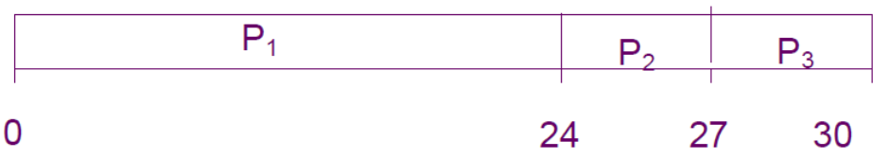
Example of FCFS
Process | Burst Time
P1 | 24
P2 | 3
P3 | 3
Suppose the processes arrive in the order: P1, P2,P3.
The Gantt Chart for the schedule is:
Waiting time for P1 = 0; P2 = 24; P3 = 27
Average waiting time= (0 + 24 + 27)/3 = 17

Slide 17
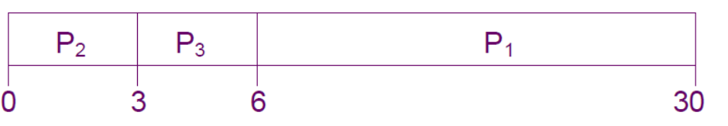
Example of FCFS (Contd..)
Suppose the processes arrive in the order P2, P3, P1.
The Gantt chart for the schedule is:
Waiting time for P1 = 6;P2 = 0; P3 = 3
Average waiting time= (6 + 0 + 3)/3 = 3

Slide 18
Reflection Spot
Q. What are the advantages and disadvantages of FCFS Scheduling Algorithm?

Slide 19
Advantages and Disadvantages of FCFS
Advantages:
Easy to implement
Works well with the processes having long burst time
Disadvantages:
Average waiting time more than SJF
Not ideal technique for time-sharing systems.

Slide 20
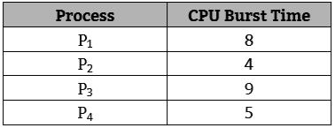

First Come First Serve (FCFS) Scheduling Algorithm
Example-1: Consider the four jobs are scheduled for execution (all jobs arrived at same time). Find the average waiting time and turnaround time.
Gantt Chart:

Slide 21
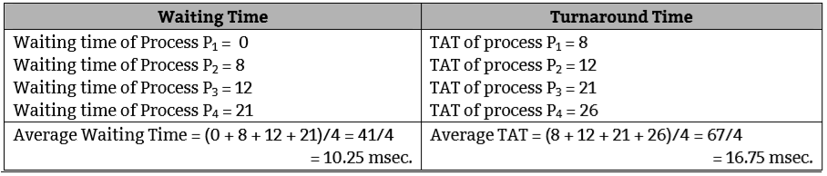
First Come First Serve (FCFS) Scheduling Algorithm

Slide 22
SJFS Algorithm/ Shortest Process Next (SPN)/ Shortest Request Next (SRN) - Introduction
The process with the shortest expected processing time is assigned to CPU first.
It is non-preemptive and preemptive algorithm.
Jobs or processes are processed in the ascending order of their CPU burst times.
Every time the job with smallest CPU burst-time is selected from the ready queue.
If the two processes having same CPU burst Time then they will be scheduled according to FCFS algorithm.
Average waiting time is short/less in SJFS as compare to FCFS
The SJF scheduling algorithm is probably optimal, It gives minimal average waiting time for a given set of processes.

Slide 23
Advantages and Disadvantages of SJFS
Advantages:
Average waiting time is less
Works well with the processes having short burst time
Disadvantages:
The waiting time of longer burst time process is more.

Slide 24
SJFS Algorithm
SJF can be evaluated in two different manners:
Non pre-emptive SJF: In this method, if CPU is executing one job, it is not stopped in between before completion.
Pre-emptive SJF: In this method, while CPU is executing a job, if a new job arrives with smaller burst time, then the current job is pre-empted (sent back to ready queue) and the new job is executed. It is also called Shortest Remaining Time First (SRTF).

Slide 25
non-preemptive SJFS Example
Example: Consider following table, find turnaround time and wait time.
Wt=st-at
Tut=et-at
Process Arrival Time Burst Time
P₁ 0.0 7
P₂ 2.0 4
P₃ 4.0 1
P₄ 5.0 4
SJF (non-preemptive)
Average waiting time = (0 + 6 + 3 + 7)/4 = 4
P1=0-0=0 , p2=8-2=6 , p3=7-4=3 . P4=12-5=7
P₁
P₃
P₂
P₄
0
3
7
8
12
16

Slide 26
preemptive SJFS Example
Process Arrival Time Burst Time
P₁ 0.0 7
P₂ 2.0 4
P₃ 4.0 1
P₄ 5.0 4
SJF (preemptive)
Average waiting time = (9 + 1 + 0 +2)/4 = 3
P₁
P₂
P₃
P₂
P₄
P₁
0
2
4
5
7
11
16

Slide 27
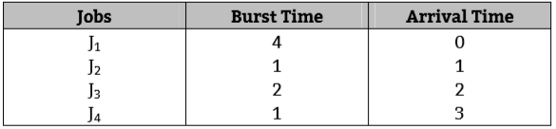
non-preemptive SJFS Example
Example 2: Consider following table, find turnaround time and wait time.

Slide 28

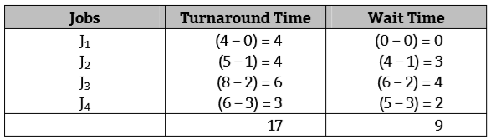

non-preemptive SJFS Example
Example 2: Consider following table, find turnaround time and wait time.
Wt=st-at
Tut=et-at

Slide 29
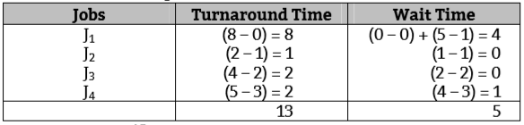

preemptive SJFS Example
_{example}
J₁
J₂
J₃
J₃
J₄
J₁
0
1
2
3
4
5
8

Slide 30
Priority Scheduling Algorithm
A priority is associated with each process and the scheduler always picks up the highest priority process for execution from the ready queue.
Equal priority processes are scheduled in FCFS order.
The priority scheduling can be either pre-emptive or non-pre-emptive.
If the priority of the newly arrived process is higher than the priority of the currently running process, the process which was allocated is interrupted and return to the queue. The higher priority job is started for execution.

Slide 31
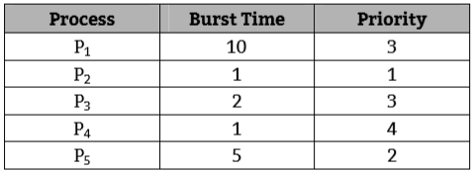
Priority Scheduling Algorithm
Example 1: Consider the following set of processes assumed to have arrived at time 0, in the order P1, P2, P3, …… P5, with the length of the CPU burst time given in milliseconds. Calculate the average TAT and Waiting Time

Slide 32
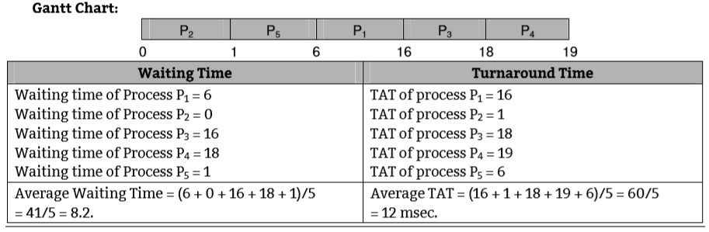
Priority Scheduling Algorithm

Slide 33
Round Robin (RR) Scheduling Algorithm
The Round Robin (RR) scheduling algorithm is designed especially for time sharing systems. RR is the pre-emptive process scheduling algorithm.
Processes are (FCFS) dispatched in a First In First Out (FIFO) sequence but each process is allowed to run for only a limited amount of time ( time quantum/time slice in ms).
In RR scheduling processes are dispatched FIFO but are given a limited amount of processor time called a time slice or a quantum.

Slide 34
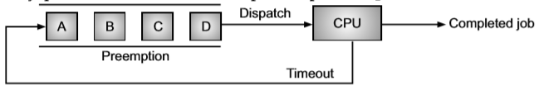
Round Robin (RR) Scheduling Algorithm
If a process does not complete before its quantum expires, the system preempts it and gives the processor to the next waiting process. The system then places the preempted process at the back of the ready queue.

Slide 35
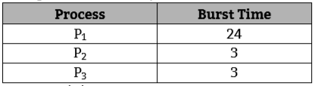

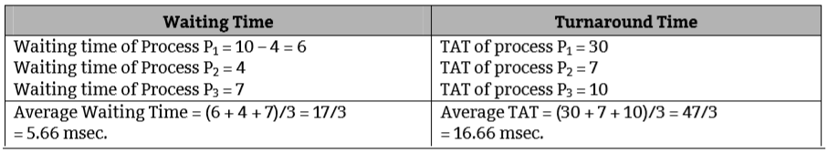
Round Robin (RR) Scheduling Algorithm
Example 1: Consider the following set of processes that arrive at time 0, with the length of CPU burst time given in milliseconds. (time quantum=4 msec.)

Slide 36
P₁
P₂
P₃
P₁
P₁
3P₁
0
4
7
10
14
18
30
P1-4ms st-0 et-4 p1-24-4=20
P2-3ms st-4 et-7 p2 out/exit
P3-3ms st=7 et-10 p3 exit
P1-4m st-10 et-14 p1=20-4=16
P1-4m st-14 et-18 p1=16-4=12
P1-4m st-18 et-22 p1=12-4=8
P1-4m st-22 et-26 p1=8-4=4
P1-4m st-26 et-30 p1=4-4=0 p1 exit

Slide 37
Multilevel Priority Queue (MLQ) Scheduling Algorithm
Multilevel Queue Scheduling based on response - time requirements. Some process required a quick response by the processor; some processes can wait
A multilevel queue scheduling algorithm partitions the ready queue into separate queues.
Depending upon their properties such as the size of the memory or the type of the process or priority of the process. So each queue follows a separate scheduling algorithm.

Slide 38
Multilevel Priority Queue (MLQ) Scheduling Algorithm
In multilevel queue scheduling algorithm scheduling the processes are classified into different groups such as System processes, Interactive processes, Interactive editing processes, Batch processes, User processes etc.
The interactive processes are known as foreground processes and the batch processes are known as background processes. These two types of processes have different response-time requirements and so may have different scheduling needs

Slide 39
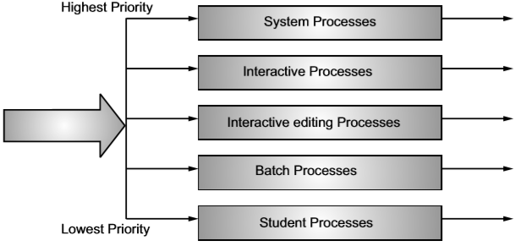
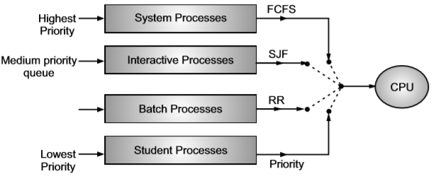
Multilevel Priority Queue (MLQ) Scheduling Algorithm
Multilevel Priority Queue Scheduling with scheduling Algorithms

Slide 40
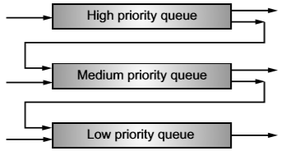
Multilevel Feedback Queue (MLFQ) Scheduling Algorithm
The MLFQ scheduling also known as multilevel adaptive scheduling is an improved version of multilevel queue scheduling algorithm.
In multilevel queue scheduling, processes cannot move from one queue to other because processes do not change their foreground or background nature. But in multilevel feedback queue scheduling, processes are not permanently assigned to a queue on entry to the system.
Instead, they are allowed to move between queues. The idea is to separate processes with different CPU burst characteristics. If a process uses too much CPU time, it will be moved to a lower priority queue.
Similarly, a process that waits too long in a low priority queue will be moved to a higher priority queue. This form of aging prevents starvation.

Slide 41
Multilevel Feedback Queue (MLFQ) Scheduling Algorithm
A multilevel feedback queue scheduler is defined by the following parameters:
The number of queues.
The scheduling algorithm for each queue.
The method used to determine when to upgrade a process to a higher priority queue.
The method used to determine when to demote a process to a lower priority queue.
The method used to determine which queue a process will enter when that process needs service.

Slide 42
Multilevel Feedback Queue (MLFQ) Scheduling Algorithm
Advantages of Multilevel Queue Scheduling Algorithm:
The multilevel feedback queue scheduling speeds up the flow of task execution.
It prevents starvation by moving a lower priority process to a higher priority queue if it has been waiting for too long.
It is fair to I/O bound (short) processes as these processes need not wait too long and are executed quickly.
It improves the overall performance of the system.
Disadvantages of Multilevel Queue Scheduling Algorithm:
The turnaround time for long processes may increase significantly.
It is the most complex scheduling algorithm.
In this algorithm, moving the processes between queues causes a number of context switches which results in an increased overhead.

Slide 43
Deadlock
Deadlock is a situation when two or more processes get locked and cannot processed further because of inter-dependability.
Deadlock is defined as, "a situation where a set of processes are blocked because each process is holding a resource and waiting for another resource acquired by some other process".
In real world, deadlocks can arise when two persons wait for phone calls from one another & example traffic jam at the time traffic signal lights goes off
Processes involved in a deadlock remain blocked permanently and this affects OS performance indices like throughput and resource efficiency.

Slide 44
Necessary Conditions to Deadlock
Mutual Exclusion: At least one resource is held in a non-sharable mode, that is only one process at a time can use the resource. If another process requests that resource, the requesting process must be delayed until the resource has been released. Each resource is either currently assigned to exactly one process or is available.
Hold and Wait: There must exist a process that is holding at least one resource and is waiting to acquire additional resources that are currently being held by another process. Process currently holding resources granted earlier can request new resources.
No Pre-emption: Resources cannot be pre-empted; i.e. resource can only be released voluntarily by the process holding it, after the process has completed its task. Resources previously granted cannot be forcibly taken away from a process. They must be explicitly released by the process holding them.

Slide 45
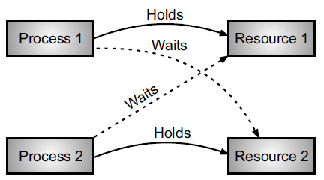
Necessary Conditions to Deadlock
Circular Wait: There exist a set (P0, P1, ----- Pn) of waiting processes such that P0 is waiting for a resource which is held by P1, P1 is waiting for a resource which is held by P2. Pn-1 is waiting for resources which are held by Pn and Pn is waiting for a resource which is held by P0. Thus there must be a circular chain of two or more processes, each of which is waiting for a resource held by the next member of the chain.

Slide 46
Deadlock Handling
A deadlock in operating system can be handled in following four different ways:
1. Adopt methods for avoiding the deadlock.
2. Prevent the deadlock from occurring (use a protocol).
3. Ignore the deadlock.
4. Allow the deadlock to occur, detect it and recover from it.

Slide 47
Deadlock Prevention
Eliminating Mutual Exclusion Condition
Eliminating Hold and Wait Condition
Eliminating No Preemption Condition
Eliminating Circular Wait Condition

Slide 48
Deadlock Prevention
A deadlock can be prevented by eliminating any one of the four necessary conditions of the deadlock which results in the inefficient use of resources. Deadlock avoidance approaches ensure that deadlocks cannot arise/occur in a system, by not allowing the conditions for deadlocks to hold simultaneously.
Deadlock avoidance requires that the operating system be given information in advance regarding the resources a process will request and use. This information is used by the operating system to schedule the allocation of resources so that no process waits for a resource.
Deadlock prevention prevent deadlocks by restraining how requests can be made. The restraints ensure that at least one of the necessary conditions for deadlock cannot occur, and hence, that deadlock cannot hold.

Slide 49
Bankers Algorithm
Banker's algorithm (Dijkstra in 1965) is a deadlock avoidance algorithm. It is named so because this algorithm is used in banking systems to determine whether a loan can be granted or not.
Banker’s algorithm in the operating system is such that it can know in advance before a resource is allocated to a process, whether it can lead to deadlock (“unsafe state”) or it can certainly manage to avoid it (“safe state”).

Slide 50
Safety Algorithm
This algorithm is used to find out whether a system is in safe state or not. This algorithm can be described as follows:
Let Work and Finish be vectors of length m and n, respectively.
Initialize Work= Available and
Finish[i] = false for i = 0, 1, ... , n – 1.
2. Find an index i such that both
(i) Finish[i] == false
(ii) Needi≤ Work
If no such i exists, go to step 4.
3. Work = Work + Allocation;
Finish[i] = true
Go to step 2.
4. If Finish[i] == true for all i, then the system is in a safe state.
This algorithm may require an order of m x n2 operations to determine whether a state is safe.

Slide 51
Deadlock Recovery
Process Termination:
Abort all deadlocked processes
Abort one process at a time until the deadlock cycle is eliminated
Resource Preemption:
Select a process for pre-emption
Rollback of the process
Prevent Starvation

Slide 52
Thank you…..
You can mail your Queries to :
a2kousarj@gmail.com

Slide 53
Thank you…..
You can mail your Queries to :
a2kousarj@gmail.com

